Slide 1

MALLA REDDY COLLEGE OF ENGINEERING & TECHNOLOGY (Autonomous Institution – UGC, Govt. of India) DEPARTMENT OF INFORMATION TECHNOLOGY
MISSING CHILD IDENTIFICATION USING CONVOLUTIONAL NEURAL NETWORK
Batch No: 19
M.SREERAM(21N31A1291)
K.SIDDHARTHA(21N31A1276)
G.PAVAN KUMAR(22N35A1212)
Under the Guidance of
Mr K.KOUSHIL REDDY
Assistant Professor

Slide 2
AGENDA
Abstract
Introduction
Existing System
Proposed system
System Requirements
System Design
UML Diagrams
Implementation
Conclusion

Slide 3
ABSTRACT
This project presents the development of a web-based Missing Child Identification Portal utilizing Convolutional Neural Networks (CNN) for face recognition. The primary objective of this portal is to assist in locating missing children by allowing users to register missing cases, upload images, and compare them with a database of known missing children. The system is built using a combination of technologies including Node.js for the backend, MySQL for the database, and Python's DeepFace library for the face recognition functionality. Upon registering a new case, an email notification system is triggered, sending relevant information and the child’s photo to all registered users of the portal. The face recognition module utilizes deep learning models to match uploaded images with the existing database, providing the ability to identify a missing child. The project emphasizes the real time identification of children based on facial features while ensuring the accuracy and efficiency of the matching process. This system can significantly reduce the time required for child identification and improve the chances of reuniting missing children with their families

Slide 4
INTRODUCTION
The Missing Child Identification Portal is designed to streamline the process of reporting and identifying missing children by leveraging advanced face recognition technology.
The platform allows users to register missing child cases by uploading photographs and providing crucial information such as the child’s age, unique features, and the location they were last seen.
These images are then stored in a secure database, which law enforcement agencies and authorized personnel can access to facilitate faster identification.
The platform’s core feature, powered by DeepFace and Convolutional Neural Networks (CNN), compares newly uploaded images with those in the database, providing accurate matches if found.
In addition, parents and authorities receive real-time notifications via email when new cases are registered, ensuring swift dissemination of information.

Slide 5
EXISTING SYSTEM
In the current landscape, various platforms, both governmental and non-governmental, address the issue of missing children. These systems often rely on manual reporting, where parents and guardians provide information about the missing child via physical forms or basic web portals. Some platforms use static databases of registered missing children, allowing users to search by criteria such as age, location, or description.
However, these methods are limited in their ability to accurately identify children, particularly when their physical appearance has changed over time. Additionally, these systems largely depend on human effort to circulate missing person reports and lack integration with advanced technologies like facial recognition to enhance the identification process.

Slide 6
DISADVANTAGES OF EXISTING SYSTEM
Manual Processes: Existing systems largely depend on manual data entry and search, which is time-consuming and prone to errors.
Inefficient Matching: Without automated face recognition, identification relies heavily on basic information like descriptions, which may not be accurate as time progresses.
Delayed Information Distribution: The process of circulating missing child information to the public is slow, often reliant on traditional media outlets or manual sharing, limiting the speed of search and rescue operations.
Lack of Public Involvement: Current systems do not effectively engage the broader community in the search for missing children, missing an opportunity to leverage collective effort.
Security Concerns: Many systems lack robust security, making sensitive data, such as the personal information of missing children and their families, vulnerable to breaches

Slide 7
PROPOSED SYSTEM
The Missing Child Identification Portal is designed to provide a streamlined, technology-driven solution for the identification and tracking of missing children. Unlike traditional methods that rely heavily on manual intervention and human effort, our system leverages the power of Convolutional Neural Networks (CNN) and facial recognition technology to automate the matching process, significantly increasing the efficiency and accuracy of child identification.
Advantages of the Proposed System:
High Accuracy with CNN: By using CNN for facial recognition, the system can detect and identify faces with high accuracy, even if the child’s appearance has slightly changed due to age or other factors. This overcomes a major limitation of traditional systems that rely on static descriptions.
Automation and Speed: The automated email notification system ensures that new cases are immediately brought to the attention of all registered users. Additionally, the face recognition process automates what would otherwise be a time-consuming manual search, allowing for faster identification.

Slide 8
Community Involvement: The system promotes active community participation by notifying users of new cases and allowing them to contribute to the search for missing children. This broadens the scope of the search beyond just law enforcement and family members.
Scalability and Flexibility: The use of modern web technologies such as Node.js and Express.js ensures that the system is highly scalable. It can handle a growing number of users and cases without compromising performance. The modular structure of the backend also allows for easy integration with other systems, such as law enforcement databases or social media platforms for broader reach.
Security and Privacy: Data security is a critical aspect of the system. The personal details of children and their families are stored securely, with restricted access to sensitive data. The system uses session management and encryption techniques to safeguard user data from unauthorized access.
Proactive Identification: With facial recognition at its core, the system doesn't just wait for people to recognize and report children—it actively compares uploaded images against the database, increasing the chances of locating a child based on sighting reports.

Slide 9
SYSTEM REQUIREMENTS
Software Requirements
Development Tools:
Frontend: React.js, Angular, or HTML/CSS/JavaScript for user interfaces.
Backend: Django, Flask, or Node.js for server-side development.
Face Recognition Technology:
DeepFace Library: For face recognition and feature extraction.
TensorFlow/Keras: For building and deploying Convolutional Neural Networks (CNN).
Database:
SQL: MySQL/PostgreSQL for structured data storage.
Hosting and Cloud Services:
AWS/GCP/Azure: For hosting the application, database, and storage.
AWS S3 or Google Cloud Storage: To store images securely.
APIs and Tools:
RESTful APIs: For communication between frontend and backend.
OpenCV: For pre-processing images before analysis.
Other Tools:
GitHub/GitLab: For version control and collaboration.
IDE: Visual Studio Code, PyCharm, or IntelliJ for coding.

Slide 10
Hardware Requirements
Development Environment:
Processor: Intel i5/i7 or AMD Ryzen 5/7 (or equivalent).
RAM: 16GB (minimum) for smooth development and testing.
Storage: At least 512GB SSD for storing libraries, datasets, and application files.
Server Hardware:
Processor: Multi-core CPUs (e.g., Intel Xeon or AMD EPYC).
RAM: 32GB or higher for handling large datasets and concurrent requests.
Storage: High-capacity HDDs/SSDs (2TB or more) for storing images and metadata.
GPU: NVIDIA GPUs (e.g., NVIDIA Tesla, RTX 3080) for faster training and image processing.
Network and Connectivity:
High-speed internet for real-time communication between users and servers.
User Hardware:
Any device (PCs, smartphones, tablets) with internet connectivity and a web browser to access the portal.

Slide 11
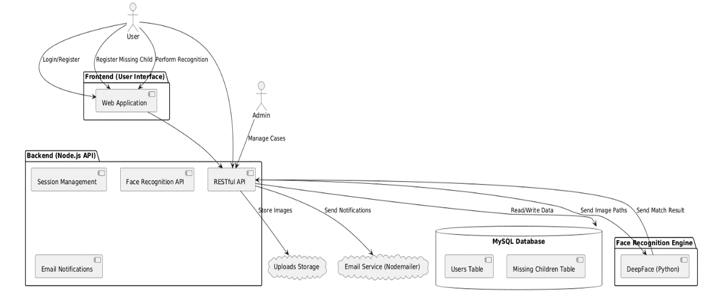
SYSTEM DESIGN

Slide 12
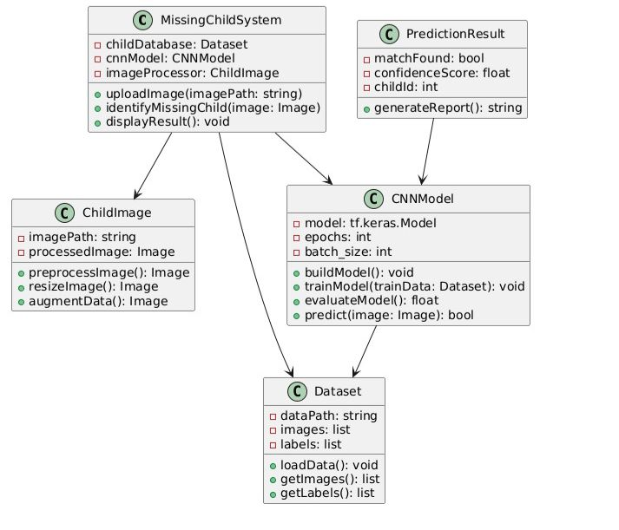
CLASS DIAGRAM:

Slide 13
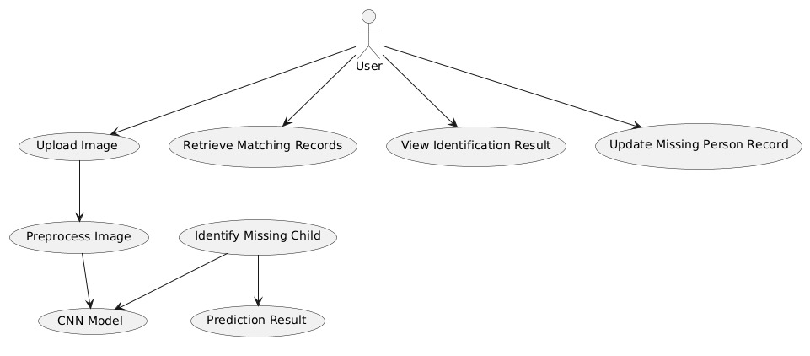
USE CASE DIAGRAM :

Slide 14
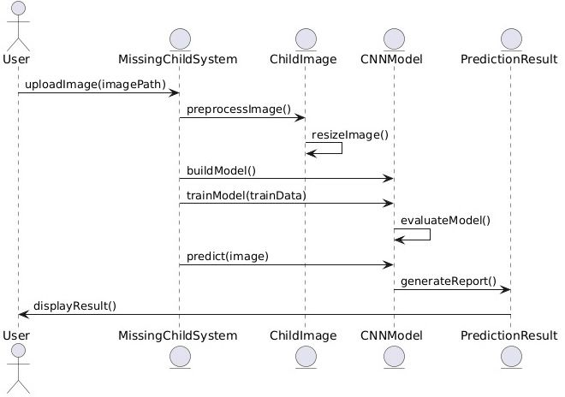
SEQUENCE DIAGRAM

Slide 15
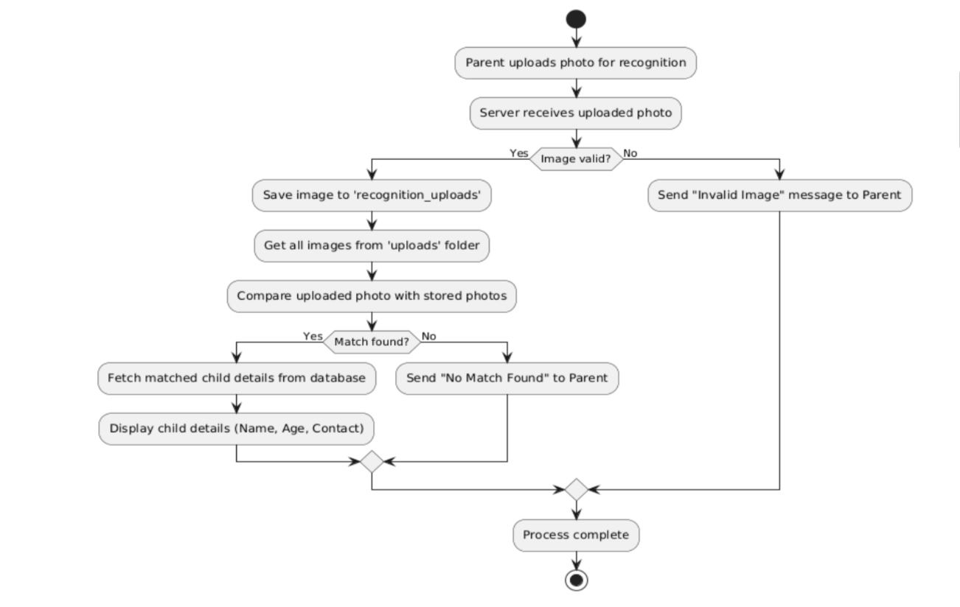
ACTIVITY DIAGRAM

Slide 16

Implementation

Slide 17

Result
Home page

Slide 18


Slide 19
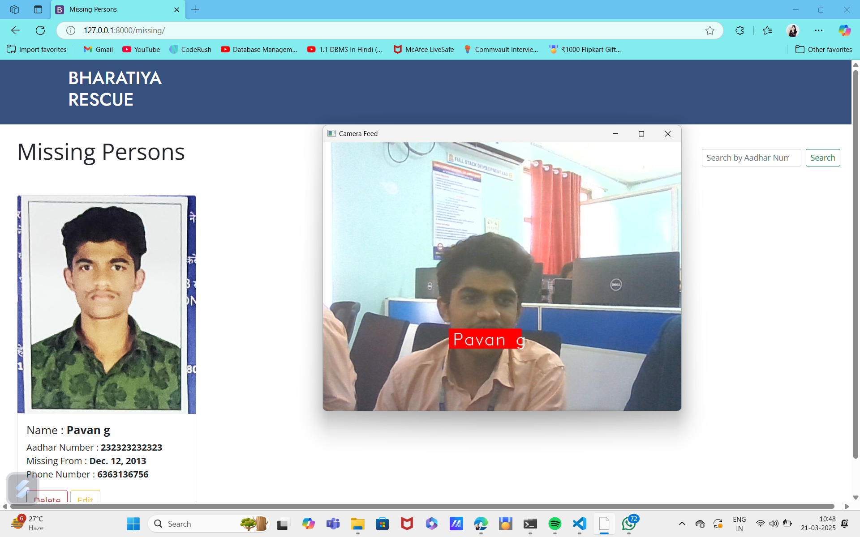

Slide 20
CONCLUSION
The missing child identification system implemented in this project serves as a comprehensive solution for addressing the critical problem of child abduction and disappearance. By integrating face recognition technology with a user-friendly portal, the system enables parents and authorities to register missing children and identify them effectively using CNN-based facial recognition models. This system streamlines the process of locating missing children and significantly improves the chances of successful reunification with their families.
In addition, the automated email notification feature ensures that the registered users are informed about new cases, thereby increasing public participation and awareness. With the successful deployment of the facial recognition algorithm and efficient backend management, the system demonstrates its ability to assist in real-world scenarios, offering a scalable and adaptable solution for missing child recovery. This project is an essential step toward leveraging technology for societal safety and enhancing collaboration between citizens, law enforcement, and technological systems

Slide 21
THANKYOU

